Slide 1


SQL Concepts for Data Analysts & Data Science
Unlock the power of data with SQL. This presentation covers fundamental concepts essential for every aspiring data analyst.
Name: Lucky Dubey

Slide 2
The Foundation: SELECT & WHERE
SELECT: Choose Your Data
WHERE: Filter Your Results
The SELECT statement is used to retrieve data from a database. It's the first step in querying information.
The WHERE clause filters records based on specified conditions, allowing you to narrow down your results.
SELECT column1, column2 FROM table_name;
SELECT * FROM customers WHERE city = 'New York';

Slide 3
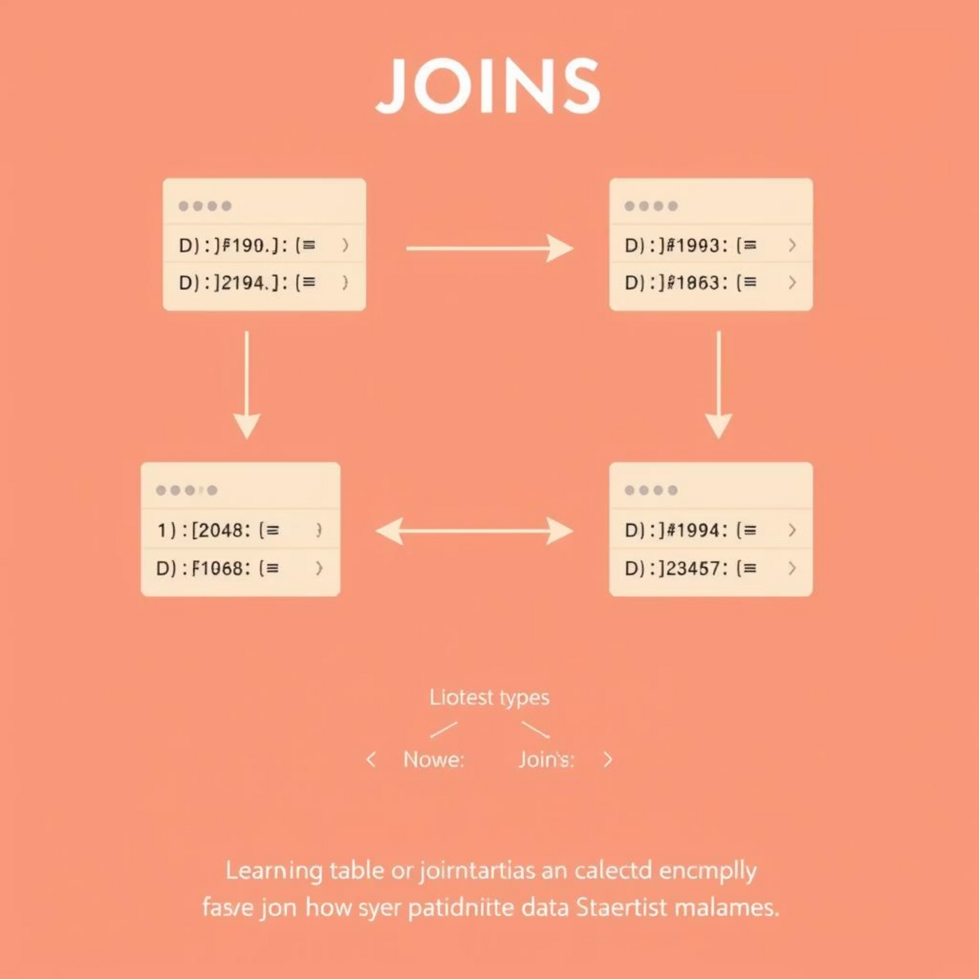
Combining Data: JOINS
JOINS are crucial for combining rows from two or more tables based on a related column between them.
Types of JOINS
INNER JOIN: Returns records that have matching values in both tables.
LEFT JOIN (or LEFT OUTER JOIN): Returns all records from the left table, and the matched records from the right table.
RIGHT JOIN (or RIGHT OUTER JOIN): Returns all records from the right table, and the matched records from the left table.
FULL JOIN (or FULL OUTER JOIN): Returns all records when there is a match in either left or right table.
SELECT orders.order_id, customers.customer_nameFROM ordersINNER JOIN customers ON orders.customer_id = customers.customer_id;

Slide 4
Organizing and Summarizing: GROUP BY & ORDER BY
GROUP BY: Aggregate Your Data
ORDER BY: Sort Your Results
The GROUP BY clause groups rows that have the same values into summary rows, often used with aggregate functions like COUNT, MAX, MIN, SUM, AVG.
The ORDER BY keyword is used to sort the result-set in ascending (ASC) or descending (DESC) order.
SELECT product_name, priceFROM productsORDER BY price DESC;
SELECT country, COUNT(customer_id)FROM customersGROUP BY country;

Slide 5



Data Manipulation: INSERT, UPDATE, DELETE
These commands allow you to modify the data within your database tables.
INSERT: Add New Data
UPDATE: Modify Existing Data
DELETE: Remove Data
Used to add new rows of data into a table. You must specify the table and the values for each column.
Used to change existing data in one or more rows of a table. Always use a WHERE clause to avoid updating all rows.
Used to remove one or more rows from a table. Be cautious; DELETE permanently removes data.
INSERT INTO customers (customer_name, city)VALUES ('Alice Smith', 'London');
DELETE FROM employeesWHERE employee_id = 205;
UPDATE productsSET price = 25.00WHERE product_id = 101;

Slide 6



Ensuring Data Integrity: Keys & Indexes
PRIMARY KEY
FOREIGN KEY
INDEXES
A unique identifier for each record in a table, ensuring no duplicate rows and quick data retrieval.
A field in one table that refers to the PRIMARY KEY in another table, establishing relationships.
Special lookup tables that the database search engine can use to speed up data retrieval.

Slide 7
Advanced Techniques: Views & Subqueries
VIEWS: Virtual Tables
SUBQUERIES: Nested Queries
A VIEW is a virtual table based on the result-set of an SQL query. It contains rows and columns, just like a real table, but its data is not physically stored.
A SUBQUERY (or inner query) is a query nested inside another SQL query. It is executed first, and its result is used by the outer query.
CREATE VIEW customer_orders ASSELECT c.customer_name, o.order_idFROM customers c JOIN orders o ON c.customer_id = o.customer_id;
SELECT employee_nameFROM employeesWHERE salary > (SELECT AVG(salary) FROM employees);

Slide 8
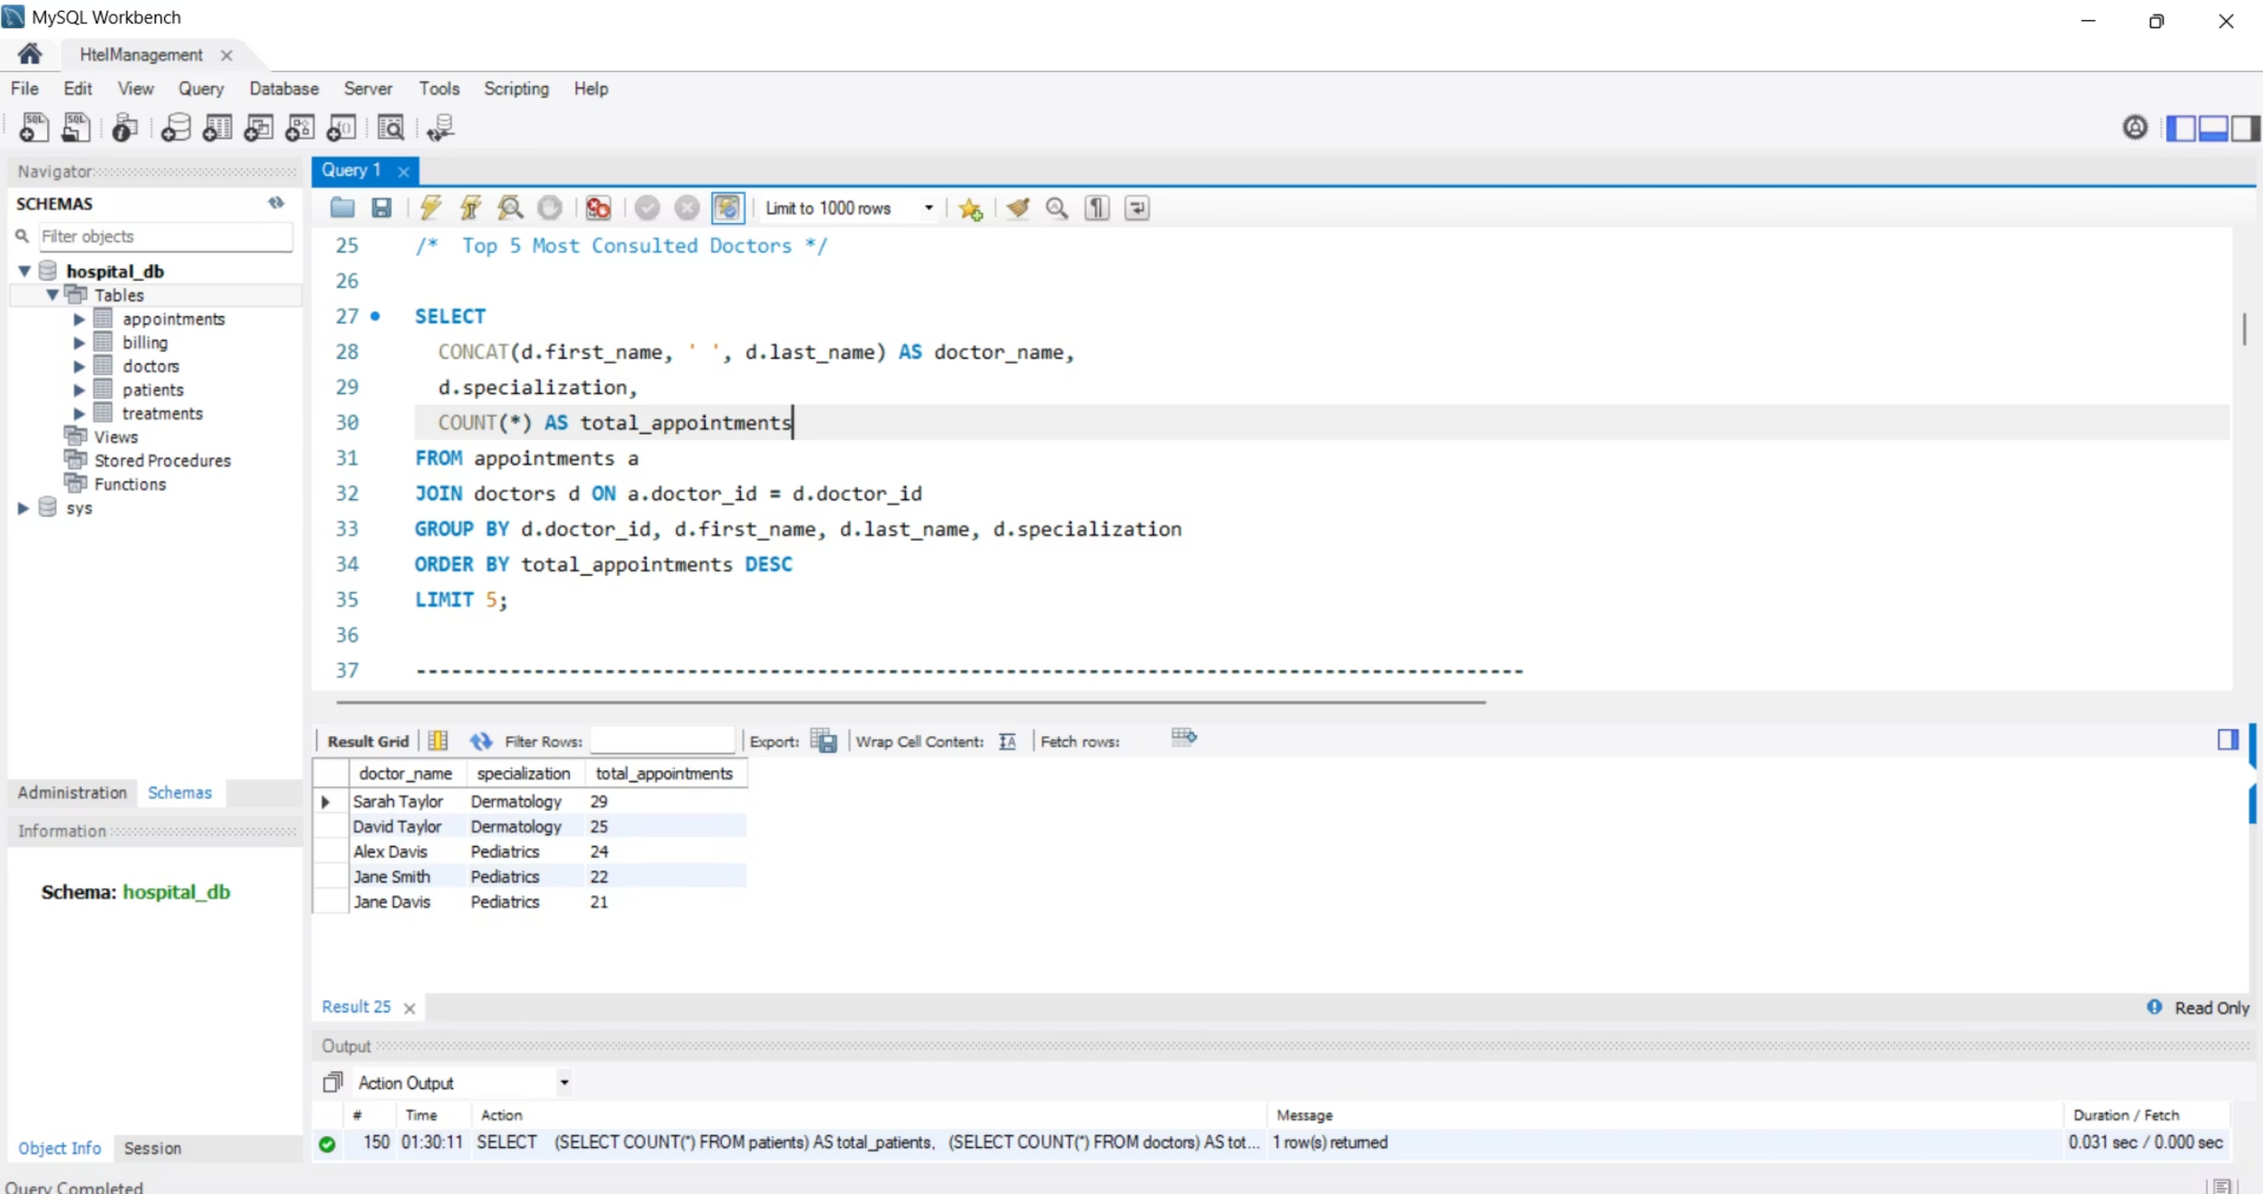

Slide 9
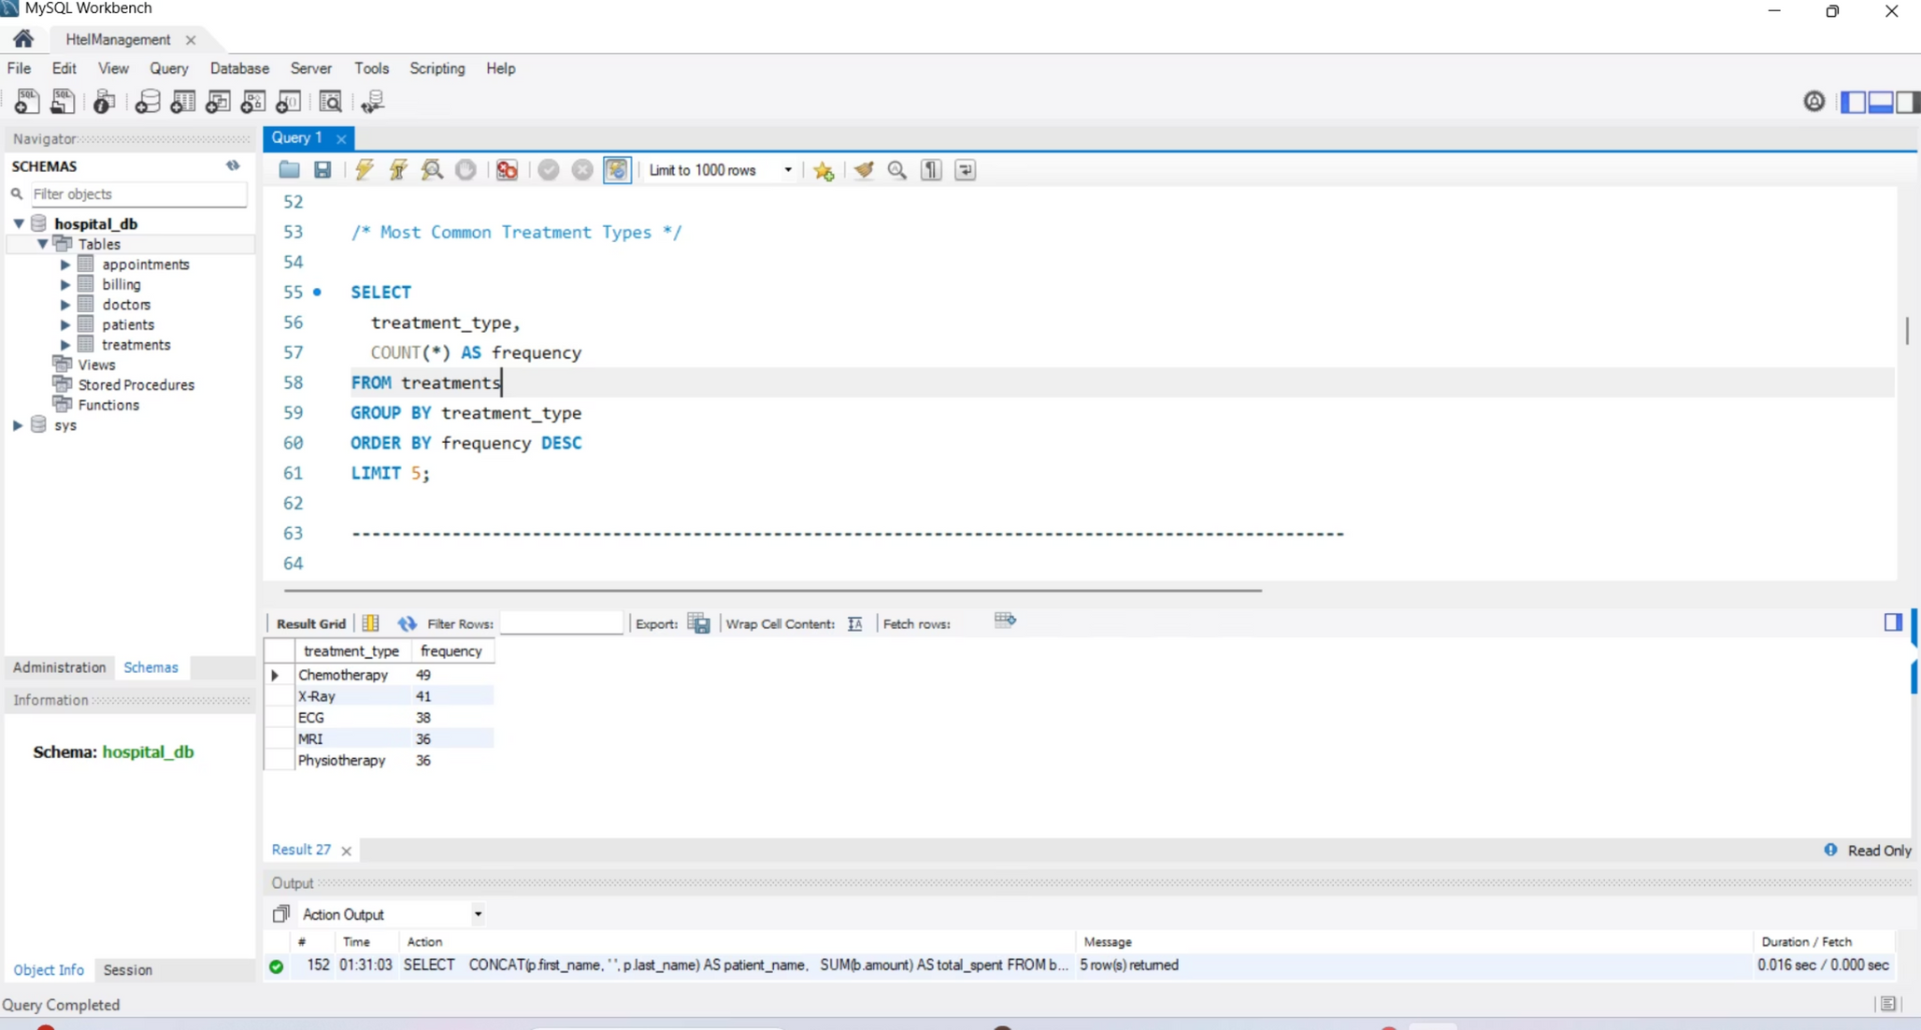

Slide 10
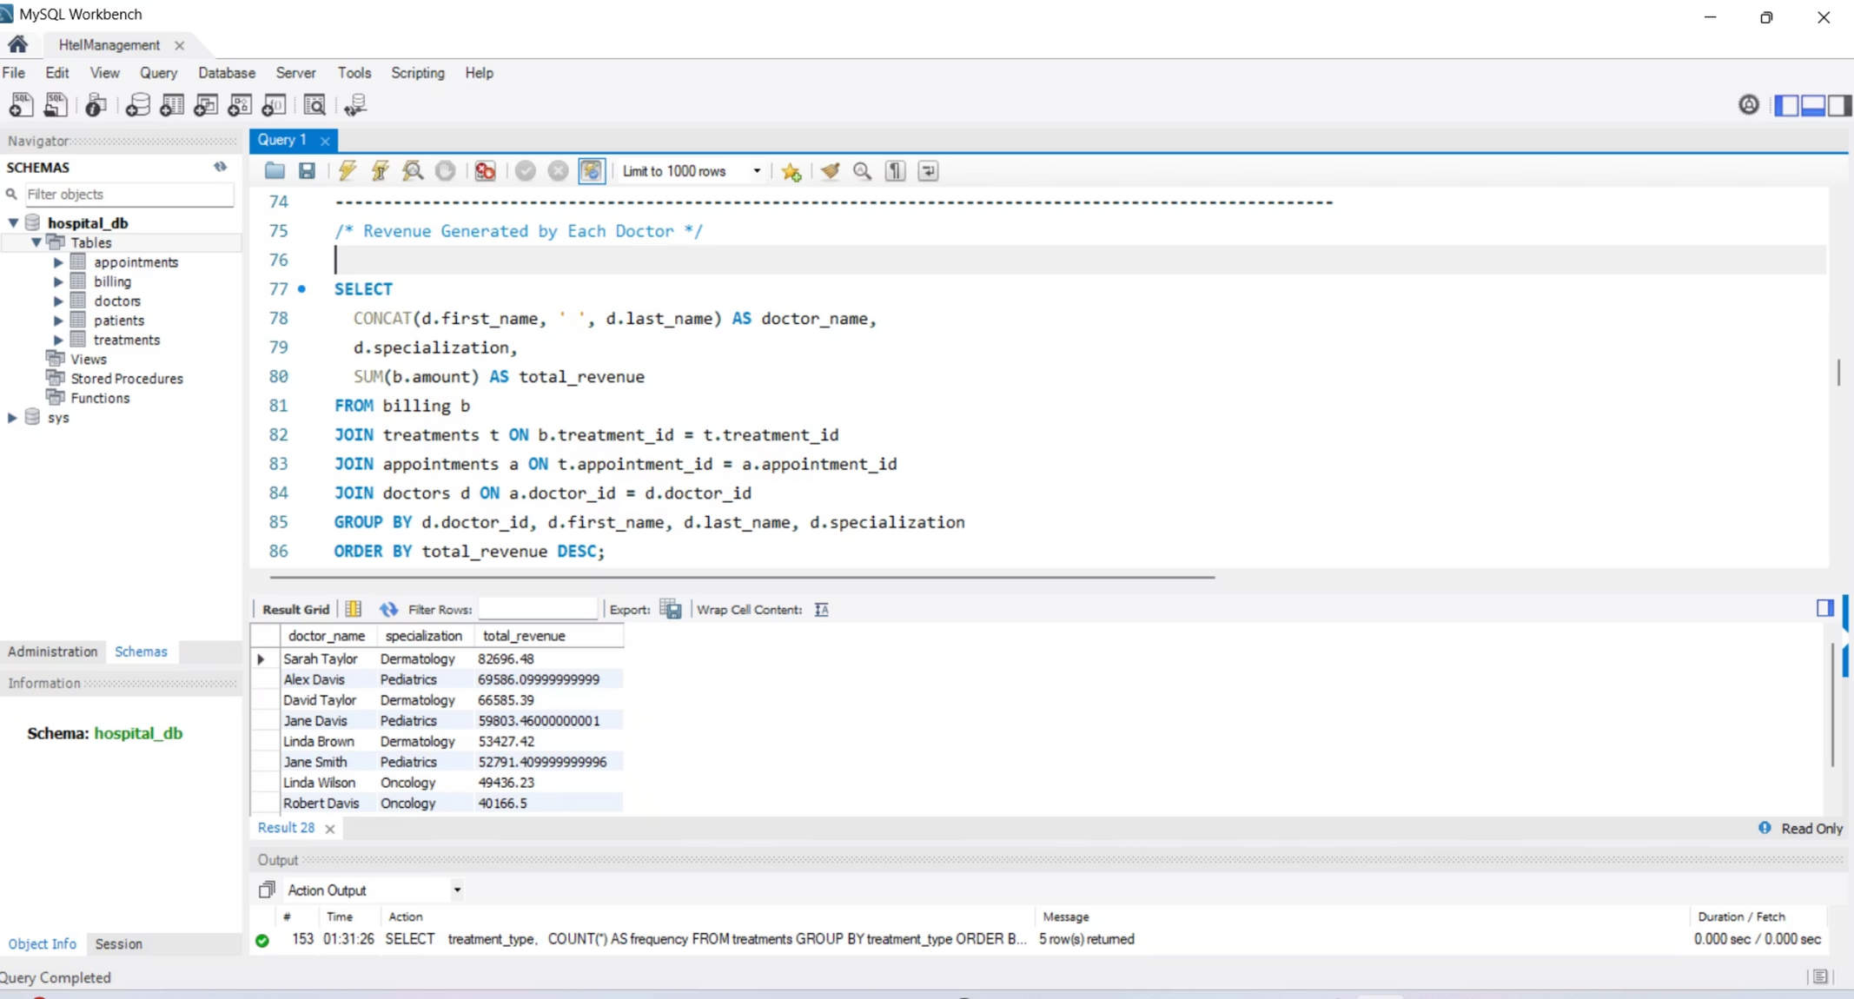
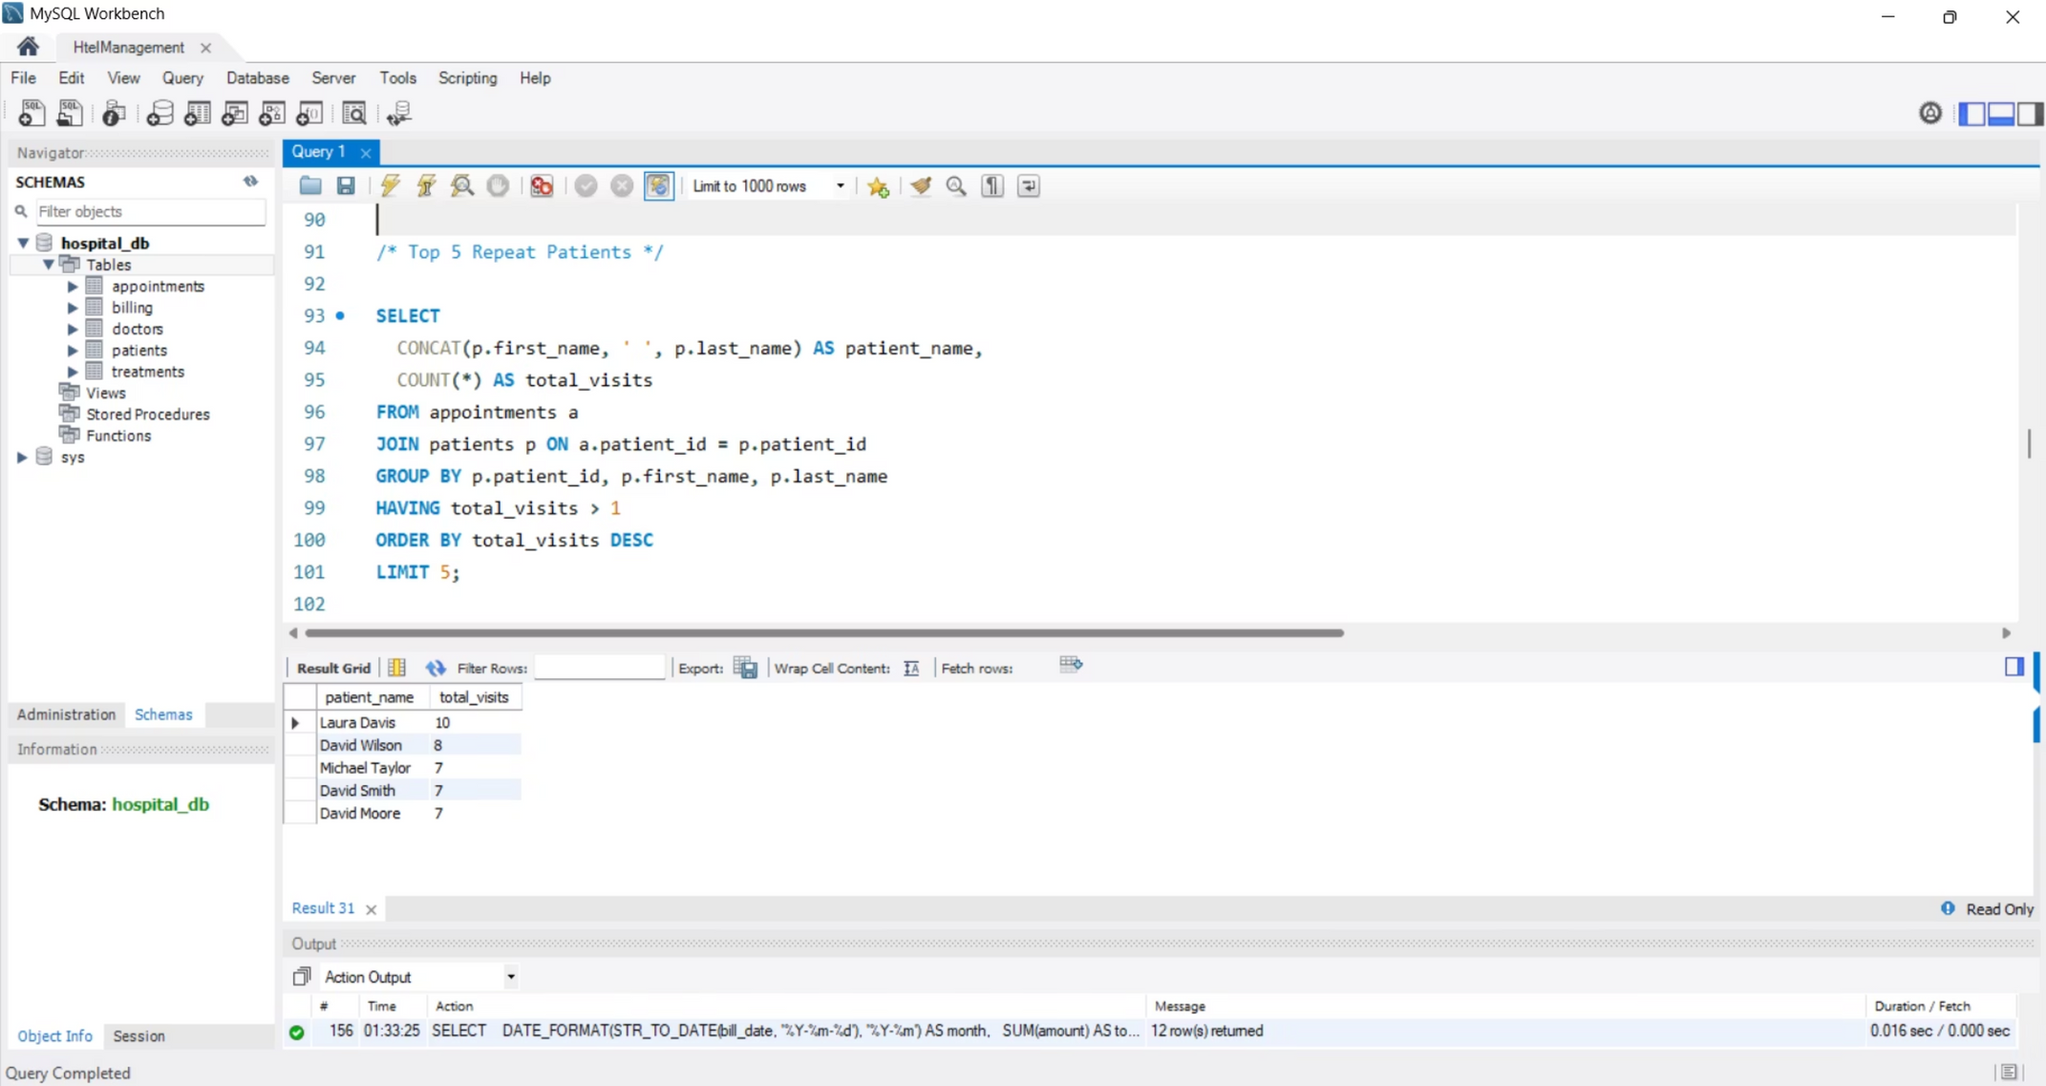

Slide 11
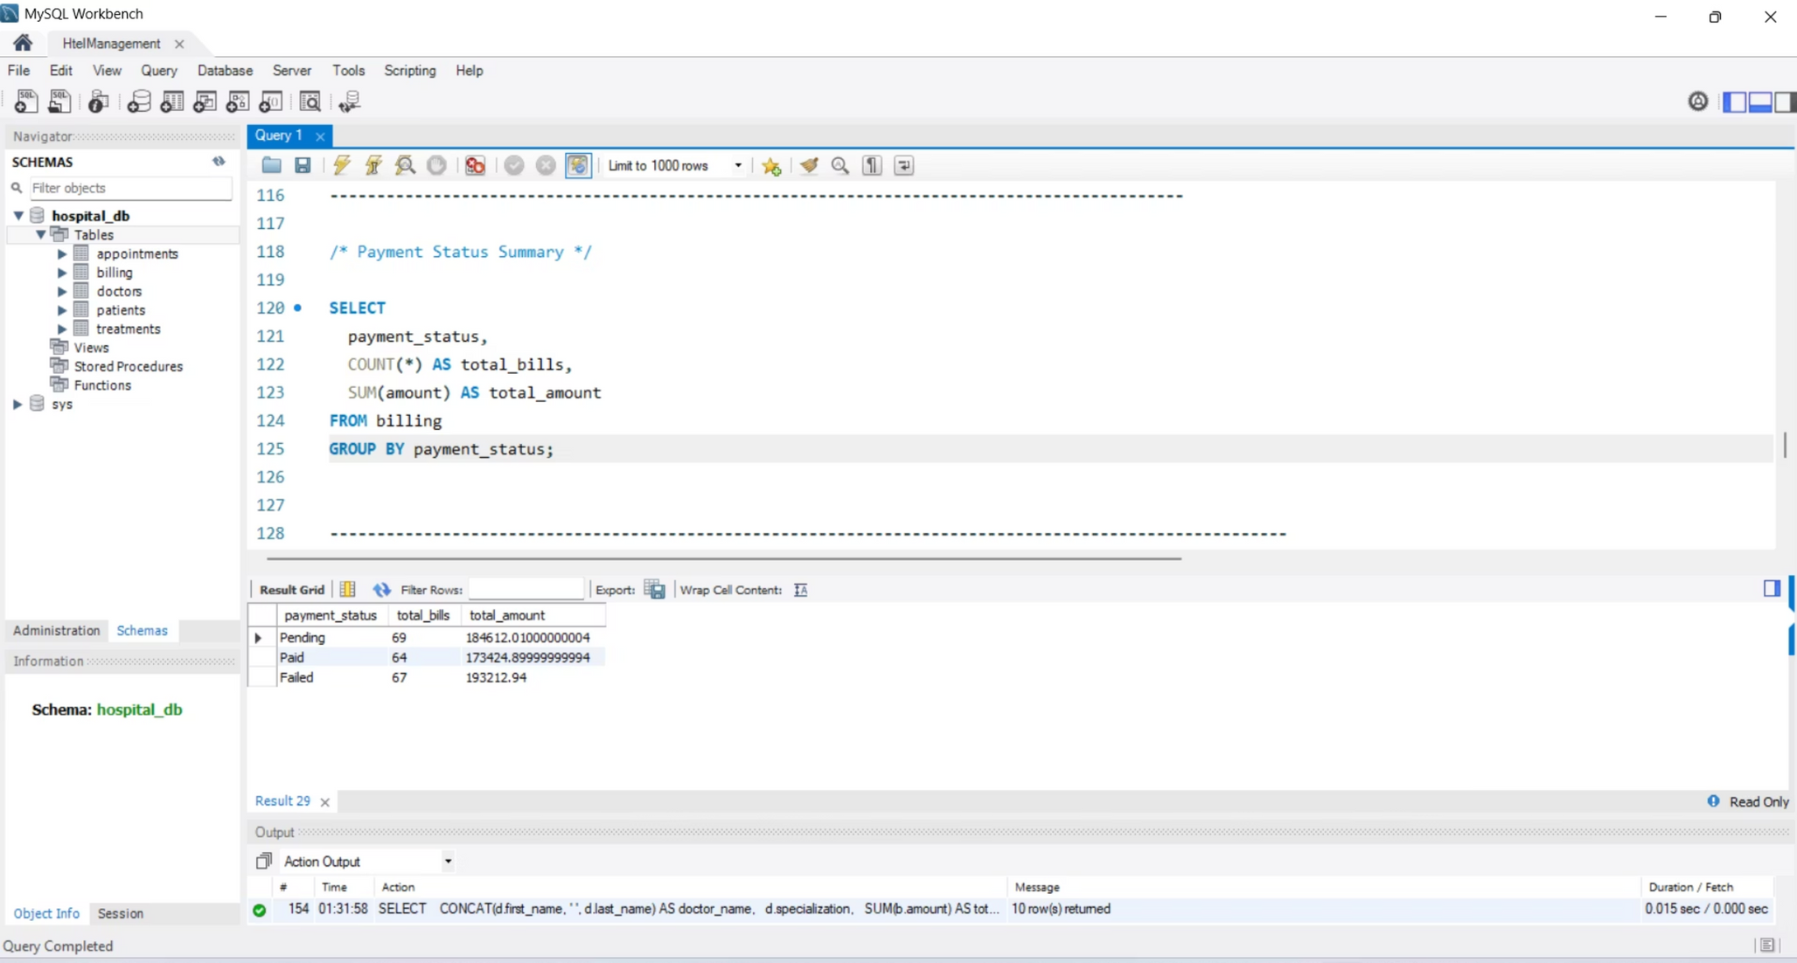

Slide 12
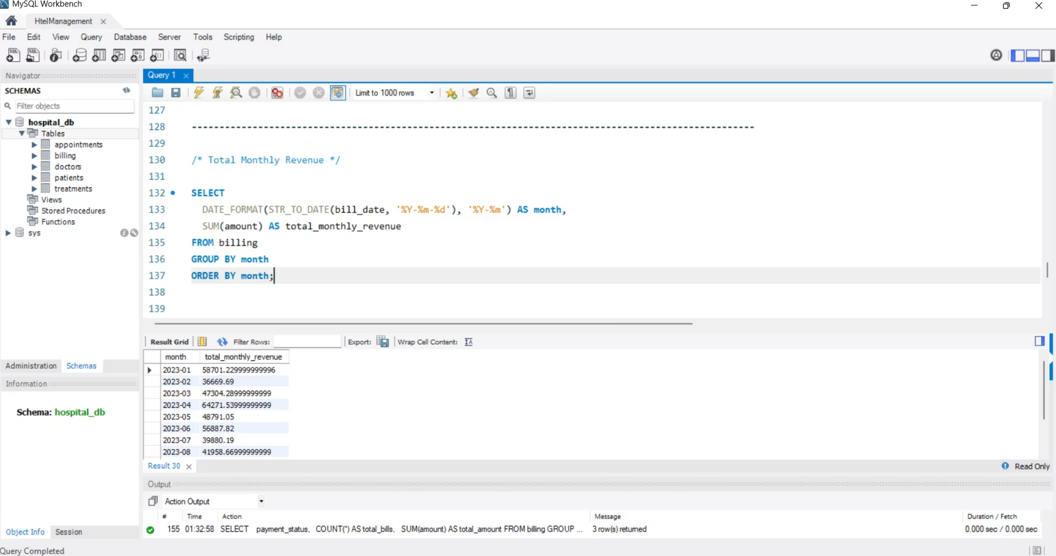

Slide 13
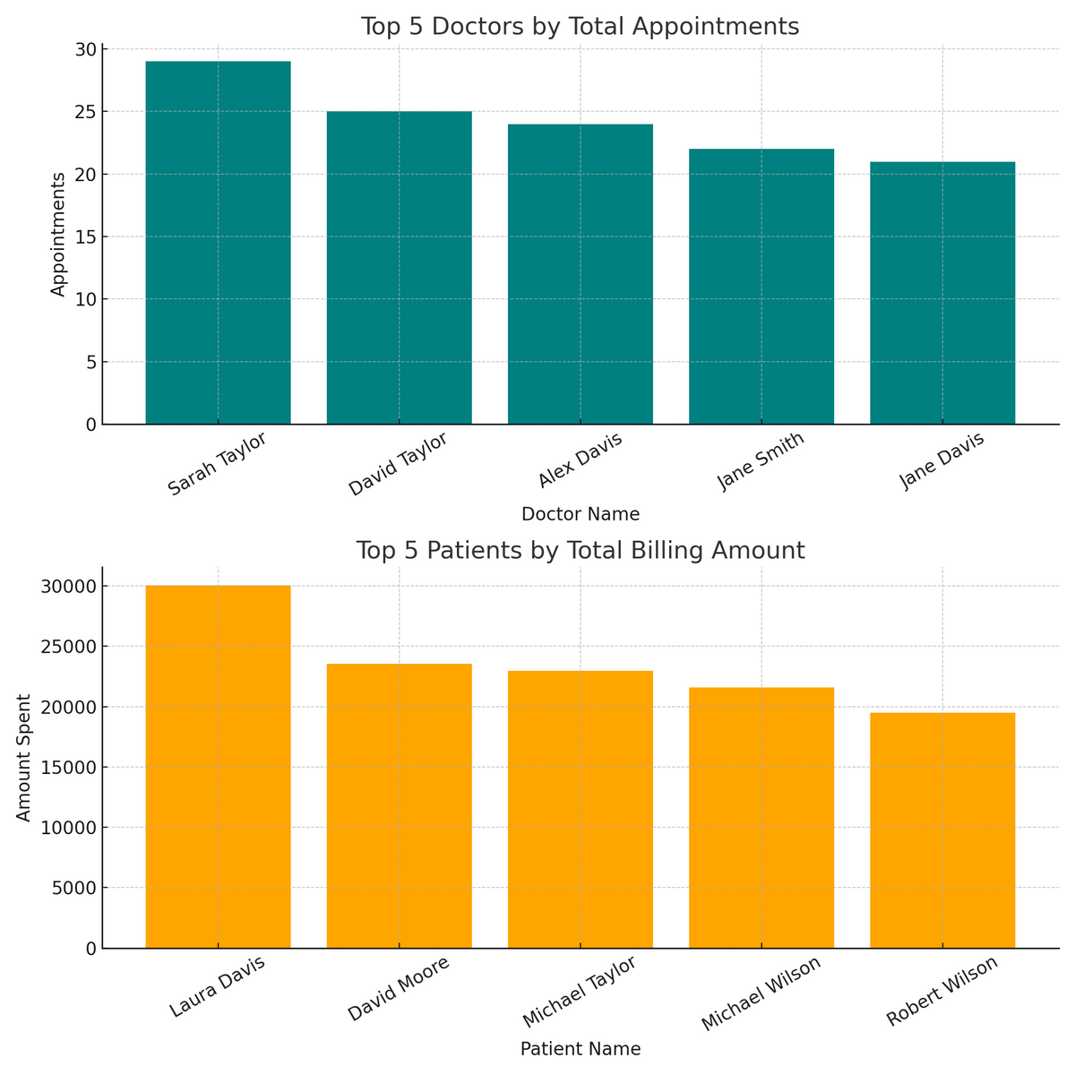
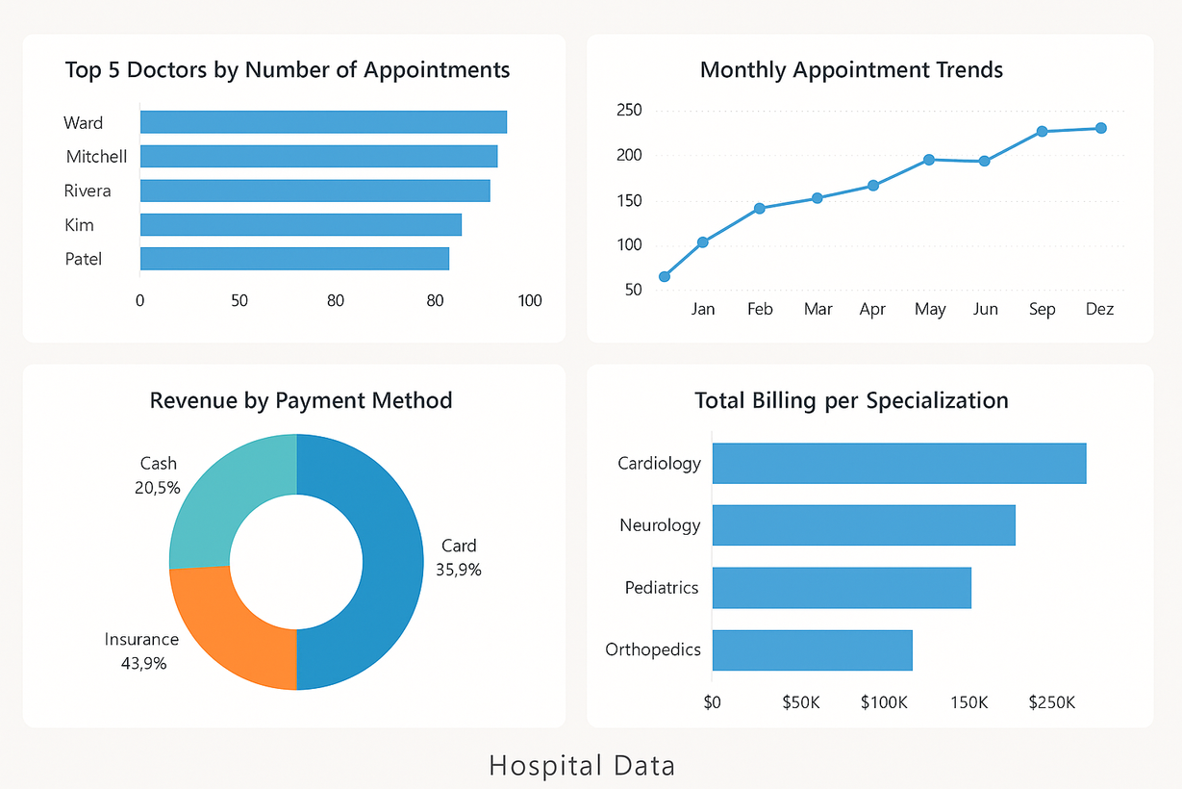
DATA ANALYSIS BY GRAPH & CHART VISUALIZATION

Slide 14
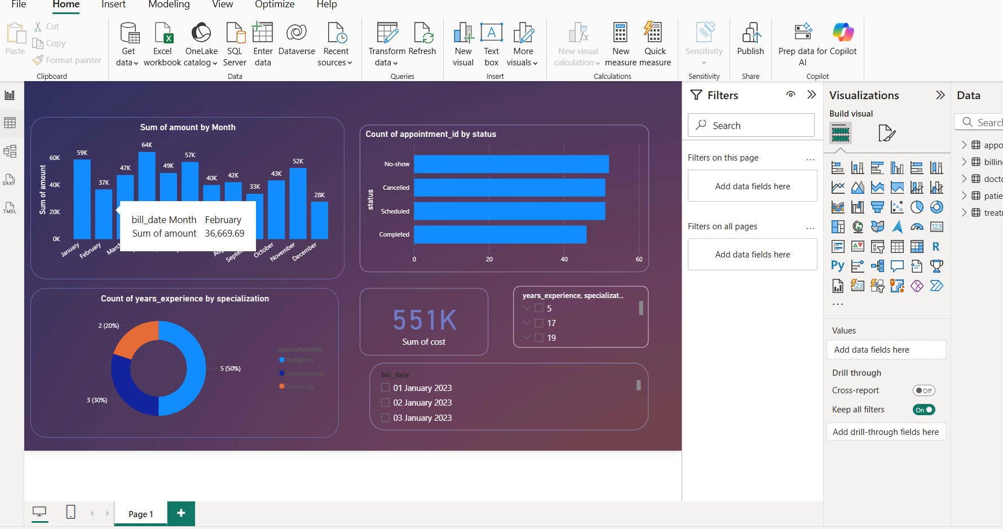
POWER BI VISUAlLIZATION

Slide 15
THANK YOU

